Slide 1
Chapter 5
Creating Complex Components

Slide 2
Objectives
From Visuals to Components
Creating the Components
The Card Component
The Square Component
The Label Component
Passing Properties
Something about JSX

Slide 3

From Visuals to Components
In the real world, what you’ll be asked to implement in React will never be as simple as a list of names or colorful blocks of vowels. Instead, you’ll be given a visual of some complex user interface, such as a scribble, diagram, screenshot, video, redline, or comp. Then it’ll be up to you to bring all those static pixels to life

Slide 4
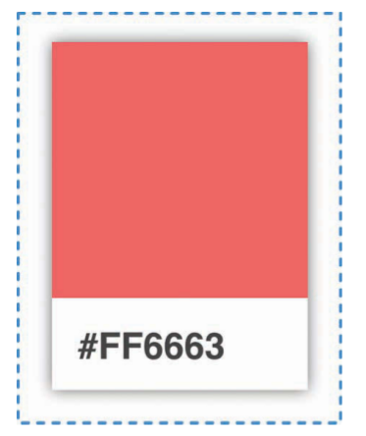
Identifying the Major Visual Elements
Mission is to re-create one of these cards using React.This approach involves two steps:
1. Identify the major visual elements.
2. Figure out what the components will be.
Both of these steps sound really complex, but as we walk through this, you’ll see that you have nothing to worry about.

Slide 5
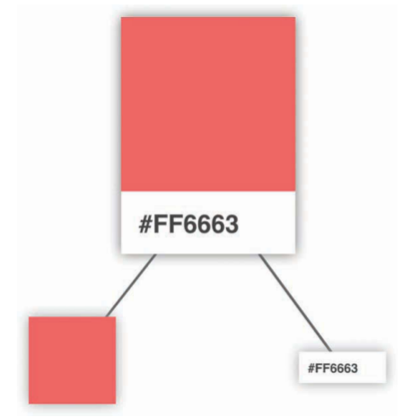
Identifying the Major Visual Elements
Within the card are two distinct regions. The top region is a square area that displays a particular color. The bottom region is a white area that displays a hex value.

Slide 6
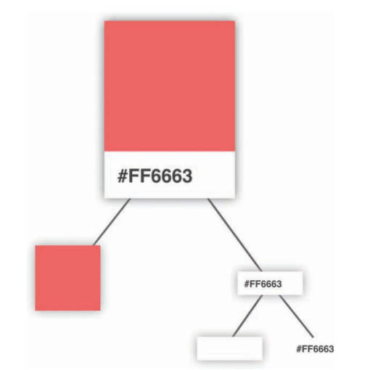
Identifying the Major Visual Elements
Continuing on, we can see that our colorful square isn’t something we can divide further. That doesn’t mean we’re done, though. We can further divide the label from the white region that surrounds it

Slide 7
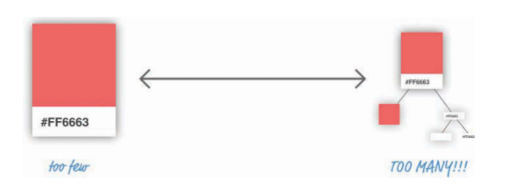
Identifying the Components
We need to figure out which of the visual elements we’ve identified will be turned into components and which ones will not. Not every visual element needs to be turned into a component, and we also don’t want to create only a few extremely complex components.

Slide 8
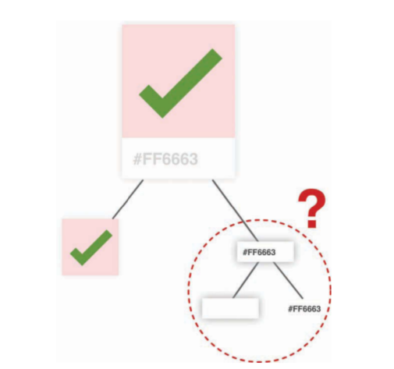
Identifying the Components
The card and the colored square seem like they fit the bill for making a great component. The card acts as the outer container, and the colored square simply displays a color.
That just puts a question mark around our label and the white region it is surrounded by

Slide 9
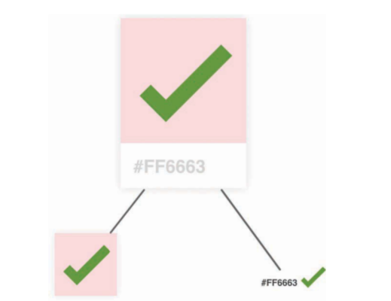
Identifying the Components
Sadly, our white rectangular region will not be turned into a component.
At this point, we have identified our three components, and the component hierarchy

Slide 10
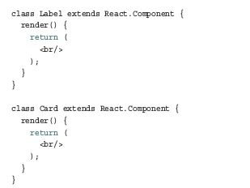
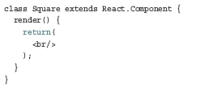
Creating the Components
The names we’ll go with for our components are Card, Label, and Square. Go ahead and add the following lines just above the ReactDOM.render function:

Slide 11
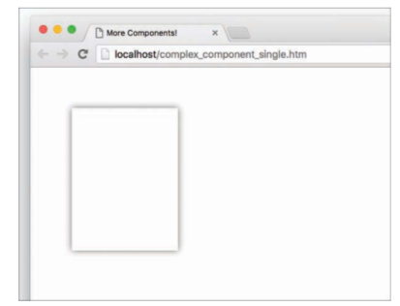
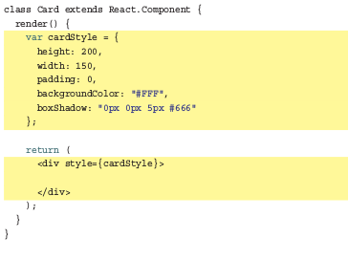
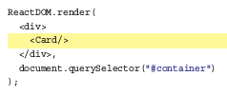
The Card Component
This component will act as the container where our Square and Label components will live.

Slide 12
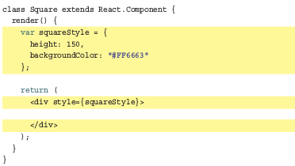
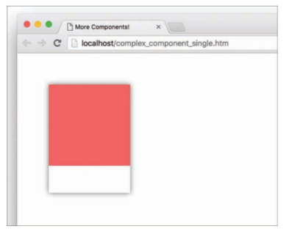

The Square Component
As with our Card component, we are returning a div element whose style attribute is set to a style object that defines how this component looks.

Slide 13
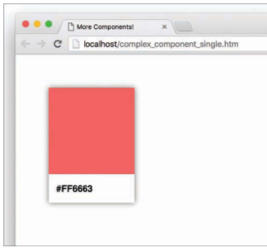
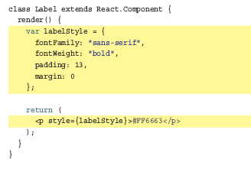

The Label Component
The last component that remains is our Label. Go ahead and make the following highlighted changes:

Slide 14
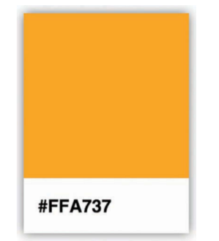
Question ??
How to show Card?

Slide 15
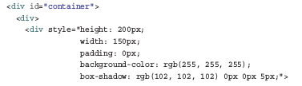
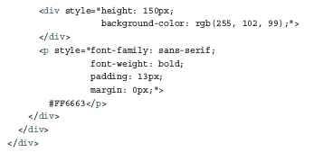
Why Component Composability Rocks
This markup has no idea how it got there. It doesn’t know about which components were responsible for what. It doesn’t care about component composability or the frustrating way we had to transfer the color property from parent to child.

Slide 16
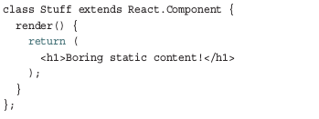
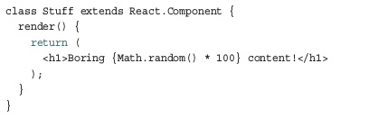
Something about JSX (1)
Evaluating Expressions:
JSX is treated like JavaScript. As you’ve seen a few times already, this means that you aren’t limited to dealing with static content like the following:
The values you return can be dynamically generated. All you have to do is wrap your expression in curly braces:

Slide 17
Something about JSX (2)
2) Return multiple elements
Although JSX doesn’t allow us to return multiple tag like that:
return (
<p>Hi</p>
<p>World</p>)
// This return is wrong!!!
However, You can return multiple by using empty tag or Fragment
Return ( Return (
<> <React.Fragment>
<p>Hi</p> <p>Hi</p>
<p>World</p> <p>World</p>
</>) <React.Fragment)
We get result same as above return without error

Slide 18
Something about JSX (3)
3) Comments in JSX
return (
<p>Hi</p>
{/* <p>World</p> */}
) // just press Ctrl + /?
4) Comments in JSX
Component name must be always capitalized.
return (
<Title />
)

Slide 19
Something about JSX (4)
5) Function return Component
Thanks to JSX, we can create function that return Component
const TextInput = (name, placeholder) => {
return(
<div>
<label>{name}</label>
<input type=’text’ placeholder={placeholder}/>
</div>
)
}
And we call that is Function Component!!!

Slide 20
Conclusion
While the approach we employed seemed really formal, as you get more experienced with creating things in React, you can ratchet down the formality.
Identifying the components is only one part of the equation. The other part is bringing those components to life. Most of the technical stuff you saw here was just a minor extension of what you’ve already seen.

